Slide 1

Computer Ports

Slide 2

Objectives
Students should be able to
Describe USB port usage
State what is an interrupt
Describe the process out the CPU servicing an interrupt
Describe the operation of the HDMI cable
Describe the operation of the VGA cable

Slide 3
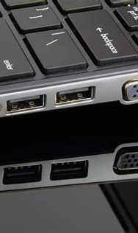
Computer Ports
Input and output devices are connected to a computer via ports.
The interaction of the ports with connected input and output is controlled by the control unit.

Slide 4
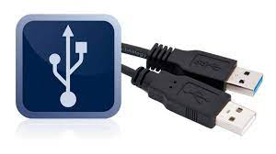
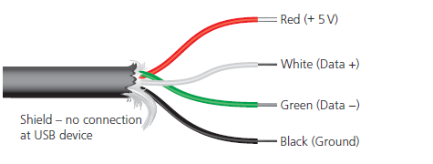
USB Port
The Universal Serial Bus (USB) is an asynchronous serial data transmission method. It has quickly become the standard method for transferring data between a computer and a number of devices.
The USB cable consists of a four-wired shielded cable, with two wires for power and the earth, and two wires used for data transmission.

Slide 5
USB Port
When a device is plugged into a computer using one of the USB ports
the computer automatically detects that a device is present (this is due to a small change in the voltage level on the data signal wires in the cable)
the device is automatically recognised, and the appropriate device driver is loaded up so that computer and device can communicate effectively
if a new device is detected, the computer will look for the device driver which matches the device. If this is not available, the user is prompted to download the appropriate software

Slide 6
Universal Serial Bus
Advantages
Disadvantages
devices plugged into the computer are automatically detected and device drivers are automatically loaded.
the connectors can only fit one way, which prevents incorrect connections being made
this has become the industry standard, which means that considerable support is available to users
several different data transmission rates are supported
newer USB standards are backward compatible with older USB standards
the present transmission rate is limited to less than 500 megabits per second
the maximum cable length is presently about five metres
the older USB standard (such as 1.1) may not be supported in the near future

Slide 7
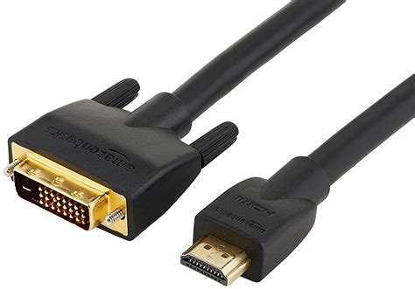
HDMI
High-definition multimedia interface (HDMI) ports allow output (both audio and visual) from a computer to an HDMI-enabled device.
They support high-definition signals (enhanced or standard).
HDMI was introduced as a digital replacement for the older Video Graphics Array (VGA) analogue system.

Slide 8
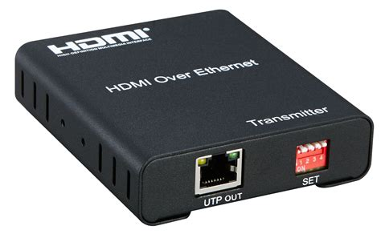
HDMI
Modern HD (high definition) televisions have the following features, which are making VGA a redundant technology:
They use a widescreen format (16:9 aspect ratio).
The screens use a greater number of pixels (typically 1920 × 1080).
The screens have a faster refresh rate (such as 120 Hz or 120 frames a second).
The range of colours is extremely large (some companies claim up to four million different colour variations).

Slide 9
HDMI
Modern HD televisions require more data, which has to be received at a much faster rate than with older televisions (around 10 gigabits per second).
HDMI increases the bandwidth, making it possible to supply the necessary data for high quality sound and visual effects.
HDMI can also afford some protection against piracy since it uses high-bandwidth digital copy protection (HDCP).
HDCP uses a type of authentication protocol. The connected device will check the authentication key of the device it is sending data to (such as an HD television).
If the key can be authenticated, then handshaking takes place and the device can start to transmit data to the connected device

Slide 10
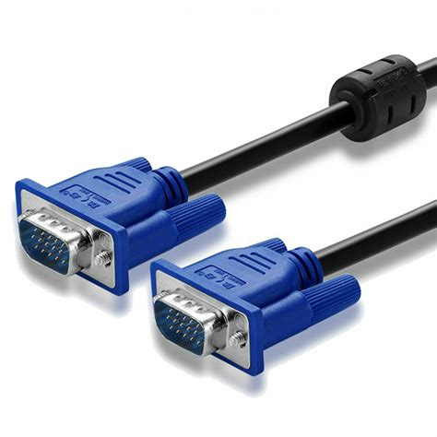
Video Graphics Array --VGA
Video Graphics Array is a standard type of connection for video devices such as monitors and projectors.
Generally, it refers to the types of cables, ports, and connectors used to connect monitors to video cards.

Slide 11
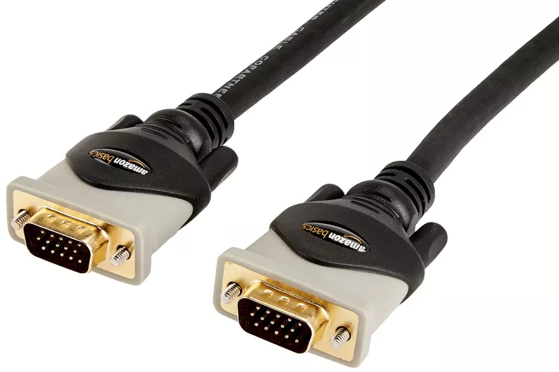
Video Graphics Array --VGA
VGA cables have 15-pin connectors: 5 pins at the top, 5 in the middle, and the other 5 at the very bottom.
A VGA port on a desktop or laptop naturally has the same number of pin holes so that a VGA cable can plug directly into it.
Each and every pin has its own function.
Example, the first pin is for transferring the color red, while the second and third are for green and blue, respectively.

Slide 12
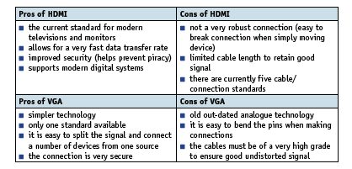
Comparison -- HDMI and VGA

Slide 13

Interrupt

Slide 14
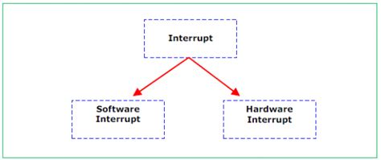
What is an Interrupt Signal?
An interrupt is a signal sent from a device or from software to the processor.
This will cause the processor to temporarily stop what it is doing and service the interrupt. Interrupts can be caused by, for example
timing signal
input/output processes (a disk drive is ready to receive more data, for example)
a hardware fault (an error has occurred such as a paper jam in a printer,
user interaction (the user pressed a key to interrupt the current process, such as <CTRL><ALT><BREAK>,
a software error that cannot be ignored (if an .exe file could not be found to initiate the execution of a program OR an attempt to divide by zero.

Slide 15
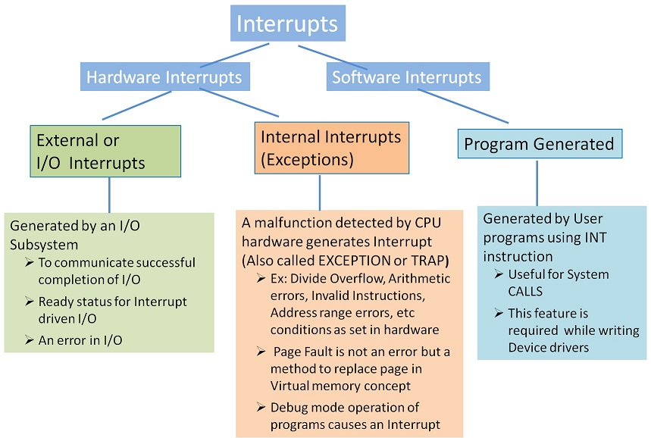
Interrupt- types
Hardware interrupt: is a signal sent by a hardware device or a specific condition in the computer's hardware. Example
When a peripheral device (e.g., a keyboard, mouse, disk drive) needs attention, it can send an interrupt request to the CPU to indicate that data is ready to be transferred.
A system timer generates regular interrupts such as scheduling tasks, keeping track of time, and triggering time-sensitive events.
Detecting an error or a critical condition (e.g., overheating, power failure).

Slide 16
Interrupt- types
Software interrupt also known as a trap or exception, is a mechanism used by a program to request a service from the operating system or to signal an event that needs attention.
Example
When a program needs to perform operations that require higher privileges or access to resources managed by the operating system (such as file I/O, network communication, etc.)
If an error condition occurs during program execution, the program might trigger a software interrupt to handle the error such as like displaying an error message or terminating the program.
A program might generate a software interrupt to indicate a specific event, such as a division by zero or an illegal instruction.

Slide 17
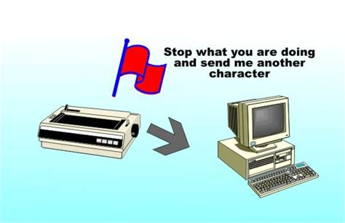
Interrupt Priority
Once the interrupt signal is received, the processor either carries on with what it was doing or stops to service the device/program that generated the interrupt.
The computer needs to identify the interrupt type and also establish the level of interrupt priority.

Slide 18
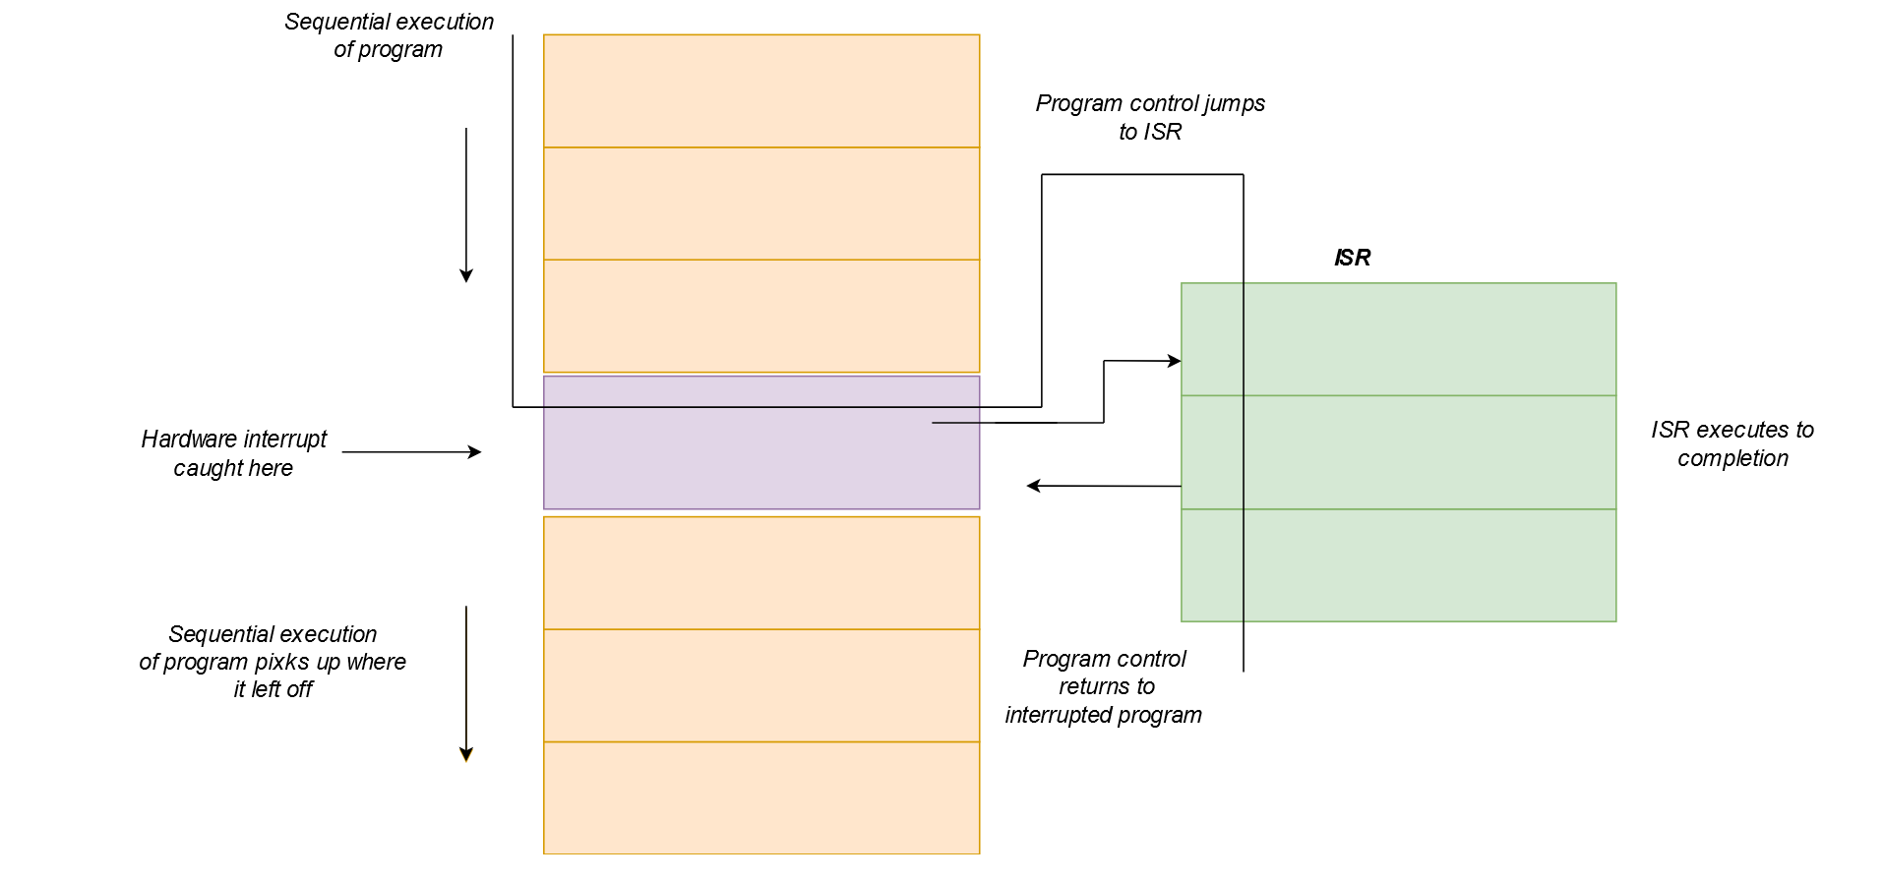
What is an interrupt handler?
Interrupt handlers, also commonly known as Interrupt service routine (ISR), is a block of code that is associated with a specific interrupt condition
Interrupt handlers are responsible for handling interrupts promptly and effectively.
Their primary role is to service interrupts and perform necessary actions associated with specific events.
Interrupt handlers ensure that time-critical tasks, such as responding to user input or processing data from hardware devices, are addressed in a timely manner.

Slide 19
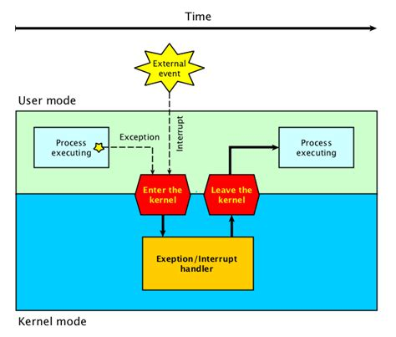
Interrupt Service Routine (ISR)
An ISR (also called an interrupt handler) is generated by an interrupt request from a hardware device. The request is sent to the CPU, interrupting the active process. When the ISR is complete, the process is resumed.
How it works?
When a device raises an interrupt at let’s say process “I”, the processor first completes the execution of instruction “I”.
Then it loads the Program Counter (PC) with the address of the first instruction of the ISR.
Before loading the Program Counter with the address, the address of the interrupted instruction is moved to a temporary location.
Therefore, after handling the interrupt the processor can continue with process “I”+1.

Slide 20
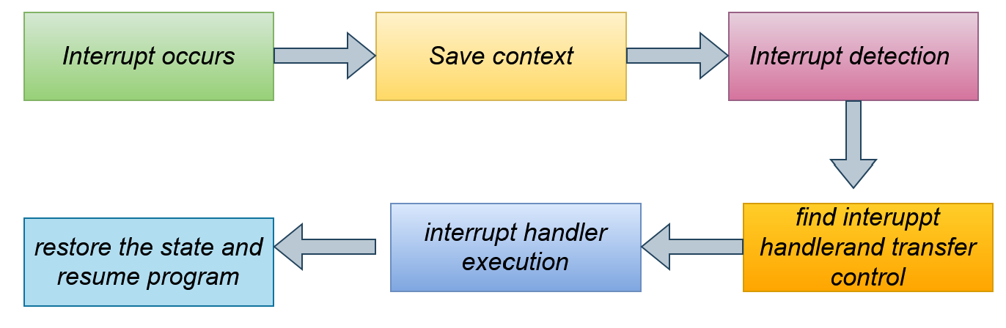
How the processor handle an interrupt
When an interrupt occurs
the processor first saves the current state of the interrupted program, including register values and the program counter.
It then identifies the specific interrupt request (IRQ) associated with the event and acknowledges the interrupt.
The processor uses the interrupt number or IRQ line to locate the corresponding interrupt handler in the interrupt vector table (IVT).
The control is transferred to the interrupt handler's memory address, where the necessary code is executed to handle the interrupt.
The interrupt handler performs actions specific to the interrupt, such as interacting with hardware devices or processing data.

Slide 21
How the processor handle an interrupt
Once the interrupt is handled, the saved state is restored, and the interrupted program resumes execution from where it left off.
This workflow ensures that interrupt events are promptly addressed while preserving the integrity of the interrupted program.
By saving and restoring the program state, interrupt handling ensures that the interrupted program can easily resume execution after the interrupt is serviced.

Slide 22

The use of Interrupt in the fetch execute cycle.

Slide 23




F-E cycle--- Interrupt
Special register called the interrupt register is used in the fetch-execute cycle.
While the CPU is in the middle of carrying out this cycle, an interrupt could occur, which will cause one of the bits in the interrupt register to change its status.
Example, the initial status might be 0000 0000 and a fault might occur while writing data to the hard drive; this would cause the register to change to 0000 1000.

Slide 24
Sequence of the Interrupt
The following sequence now takes place.
At the next fetch-execute cycle, the interrupt register is checked bit by bit.
The contents 0000 1000 would indicate an interrupt occurred during a previous cycle and it still needs servicing.
The CPU would now service this interrupt or ignore it for now, depending on its priority.
Once the interrupt is serviced by the CPU, it stops its current task and stores the contents of its registers
Control is now transferred to the interrupt handler (or interrupt service routine, ISR).
Once the interrupt is fully serviced, the register is reset and the contents of registers are restored.

Slide 25
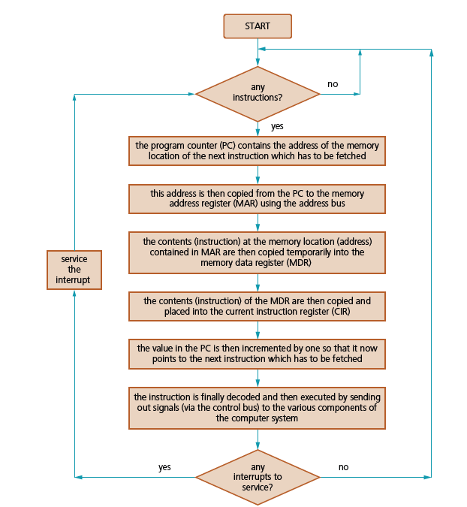
Flowchart to show the F -E cycle with an interrupt

Slide 26
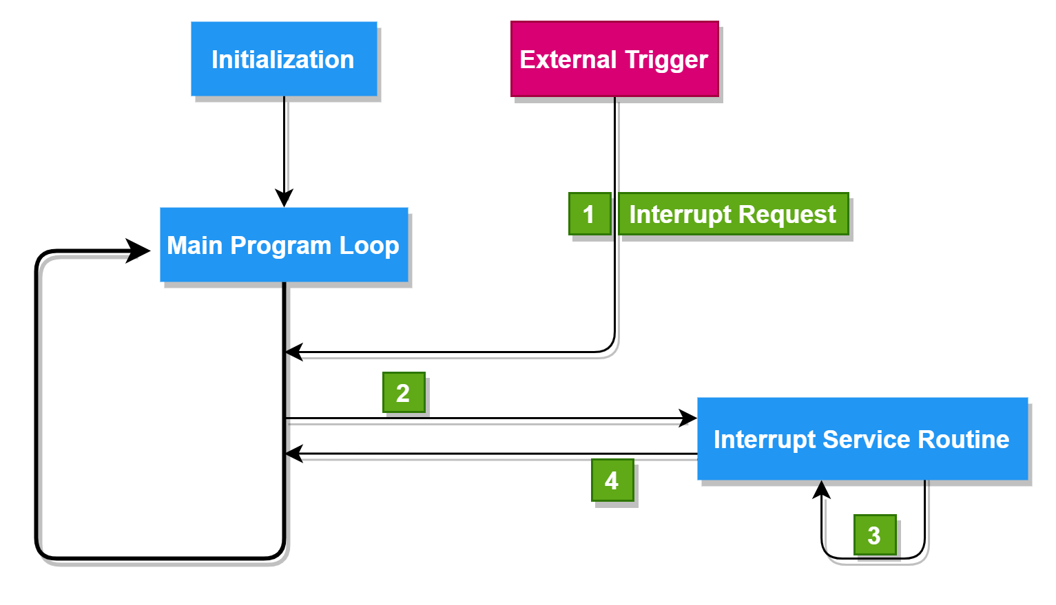
How interrupt are handled by different processor
RISC processors due to their simplified instruction set and architecture, often handle interrupts in a straightforward and efficient manner.
Support multiple interrupt levels or priority levels. This allows the processor to prioritize interrupts based on their urgency or importance.
When an interrupt occurs, the processor checks the priority of the interrupt against the current priority level, and if necessary, switches to a higher-priority task.
It uses a simple interrupt vector table (IVT) to store the addresses of the Interrupt Service Routines (ISRs).
It uses the interrupt number to index the IVT and retrieve the address of the corresponding ISR.
To prevent nested interrupts, RISC processors often disable further interrupts while processing the current one.

Slide 27
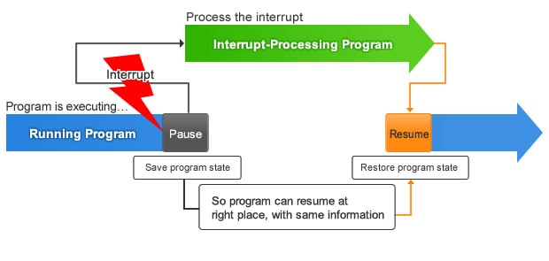
How interrupt are handled by different processor
CISC processors general handle interrupt similar to RISC processor.
CISC may have more complex interrupt handling mechanisms to accommodate the variety of instructions and the potential need for more extensive state saving and restoration.
Handling interrupts may involve more microcode or specialized hardware.
What is a microcode
Microcode is a low-level hardware abstraction layer that exists within the processor. It provides a way to implement complex instructions by breaking them down into a series of simpler, more fundamental operations. This allows the processor to execute a wide range of instructions using a relatively simple set of hardware elements.

Slide 28


Thank you
Presenter name
Email address
Website

